Slide 1
BATCH-8
BATCH MEMBERS
1. I.SAHITHI -241FA04298
2. B.PRAVEEN-241FA04328
3. V.BHUVANA-241FA04341
4. T.SIVAKUMAE-241FA04345

Slide 2


Introduction to Curl
Curl measures the rotation or swirling strength in a vector field. It reveals how vectors spin around a point. Essential in vector calculus and physics, curl helps analyze rotational forces and flows.
by TADIBOINA SIVAKUMAR4345

Slide 3
Mathematical Foundation of Curl
Curl as an Operation
Cartesian Formula
2D and 3D Examples
It transforms a vector field into another vector field, capturing rotation.
The curl involves partial derivatives of vector components, leading to a vector output.
In 2D, curl simplifies to a scalar; in 3D, it yields a vector showing rotation axis.

Slide 4

Del Operator and Curl
Del Operator (∇)
Curl Expression
A vector differential operator representing gradients, divergence, and curl.
Curl is the cross product of del with a vector field: ∇ × F, simplifying notation.
Advantages
Provides compact, elegant formulae and facilitates calculus operations.

Slide 5
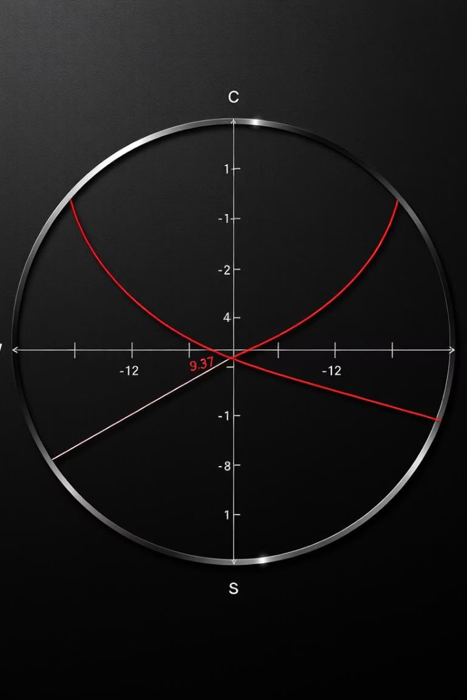



Theorems Related to Curl
Stokes' Theorem
Relates curl over a surface to the line integral around its boundary.
Divergence Theorem
Links flux of curl-related vector fields to volumetric properties.
Practical Examples
Used in calculating circulation and flux in electromagnetism and fluid flow.

Slide 6
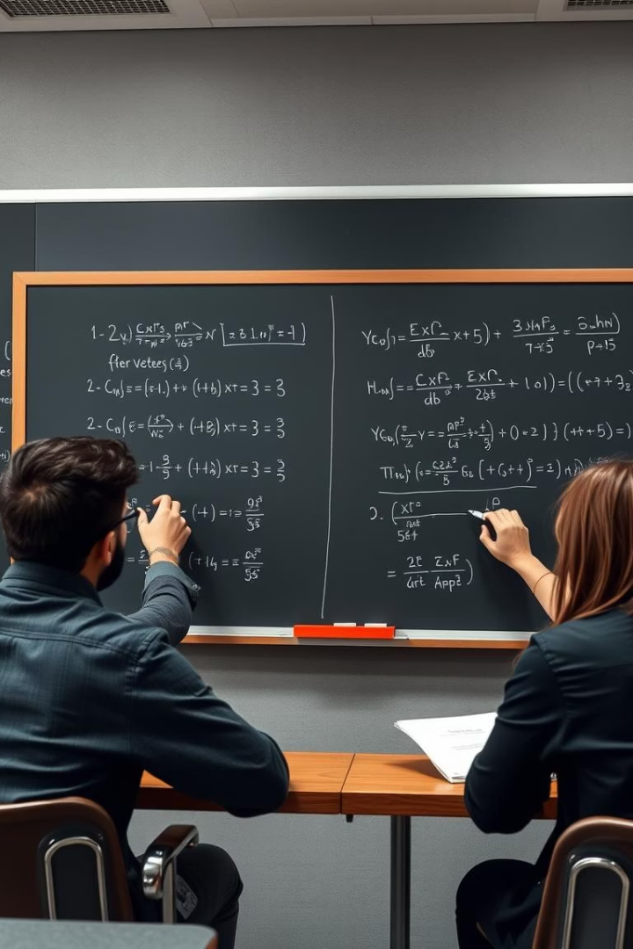
Curl in B.Tech Mathematics Curriculum
Core Topic
Problem Solving
Integral to vector calculus and multivariable calculus courses in B.Tech programs.
Practice involves calculating curl, interpreting physical meanings, and applying theorems.
Integration
Links with divergence, gradient, and differential equations in engineering contexts.

Slide 7
Applications in Fluid Dynamics
Fluid Rotation
Vortices and Eddies
Weather Patterns
Curl indicates the local spinning motion or vorticity in fluid flow.
Examples include whirlpools and atmospheric eddies showing rotational behavior.
Curl helps explain cyclones, tornadoes, and turbulent wind flows.

Slide 8
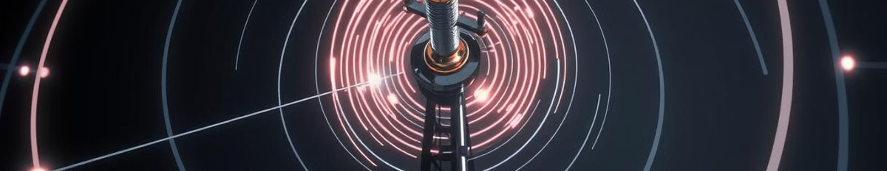
Applications in Electromagnetism
Maxwell's Equations
Magnetic Fields
Technological Examples
Curl appears in Maxwell's equations defining how fields change and interact.
Curl of electric fields relates to magnetic fields, crucial for electromagnetism.
Used in antennas, electric motors, and generators for field analysis.

Slide 9
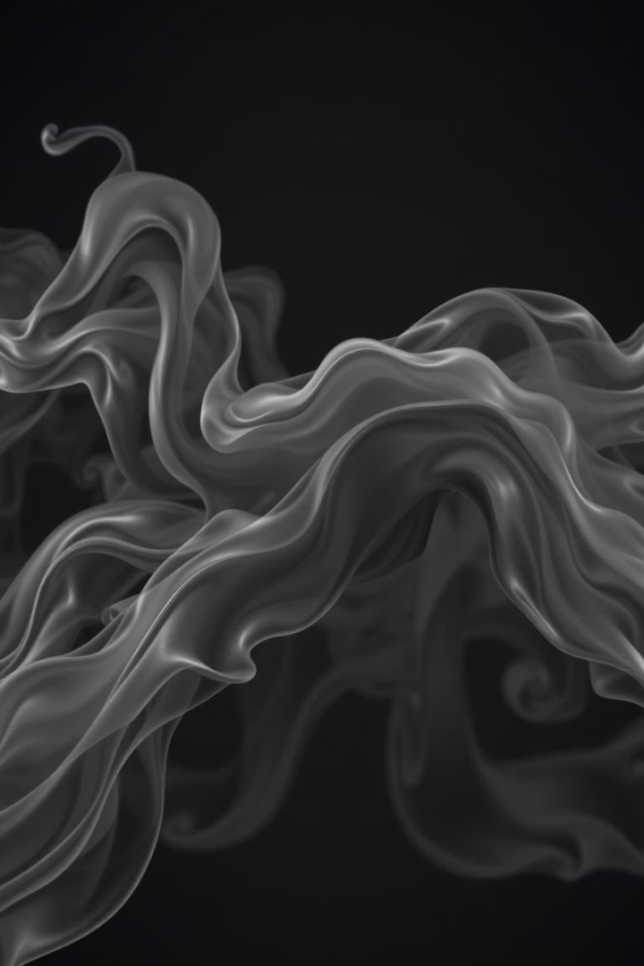
Applications in Computer Graphics
Vector Fields in 3D
Curl models rotational motion in fluid and particle simulations.
Realistic Effects
Used for smoke, fire, and water dynamics to enhance realism.
Simulation Techniques
Incorporates curl for vortex creation and natural swirling motions.

Slide 10



Advanced Topics and Research
Research Focus
2
Exploring curl in complex systems, fluid turbulence, and topology.
Non-Euclidean Spaces
1
Studying curl in curved geometries for general relativity and advanced physics.
Open Problems
Understanding curl behavior in chaotic flows and novel materials.
3

Slide 11
Conclusion and Summary
Key Concepts
Engineering Importance
Next Steps
Curl measures rotational behavior in vector fields, vital in math and physics.
Essential in fluid dynamics, electromagnetism, and computer graphics applications.
Explore advanced math courses and practical simulations for deeper understanding.

Slide 12
THANK YOU

